Slide 1
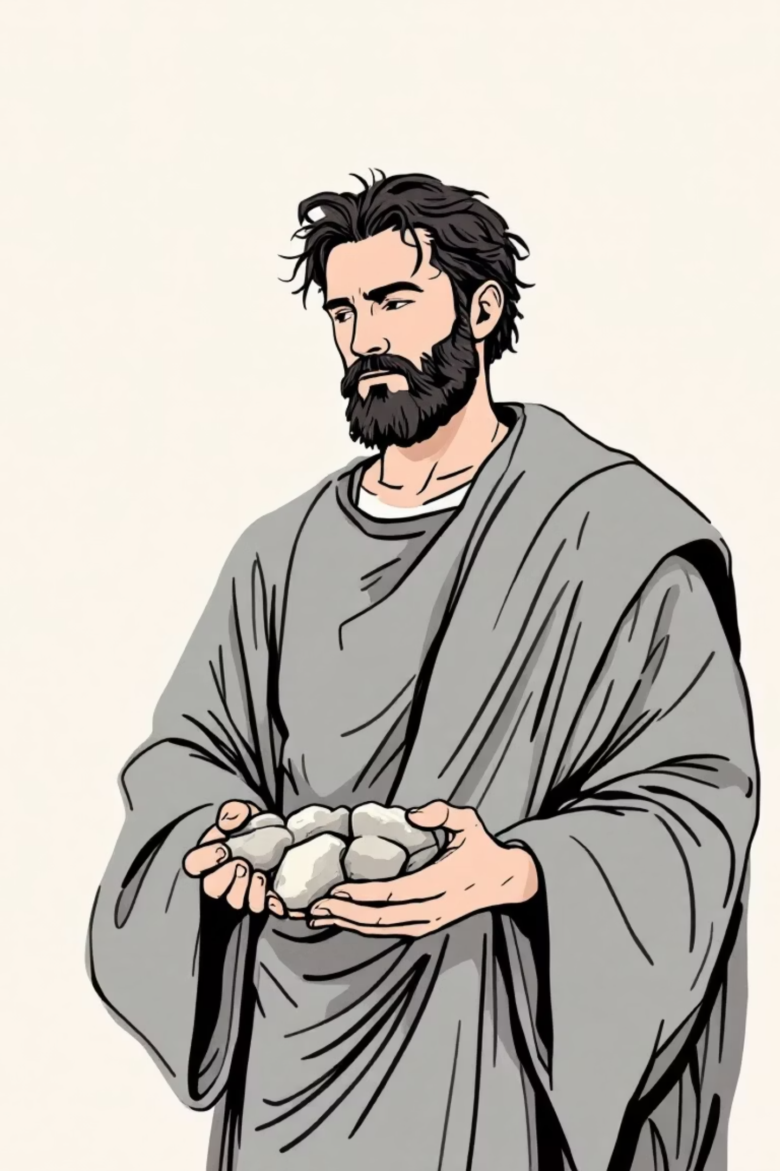
Feast of St Stephen – 26th December
Today we are going to learn about St Stephen the Martyr.
St Stephen is a very important saint in the Catholic Church because he was the first Christian martyr. That means he was the first person to die for believing in Jesus.
St Stephen is the patron saint of our school.

Slide 2
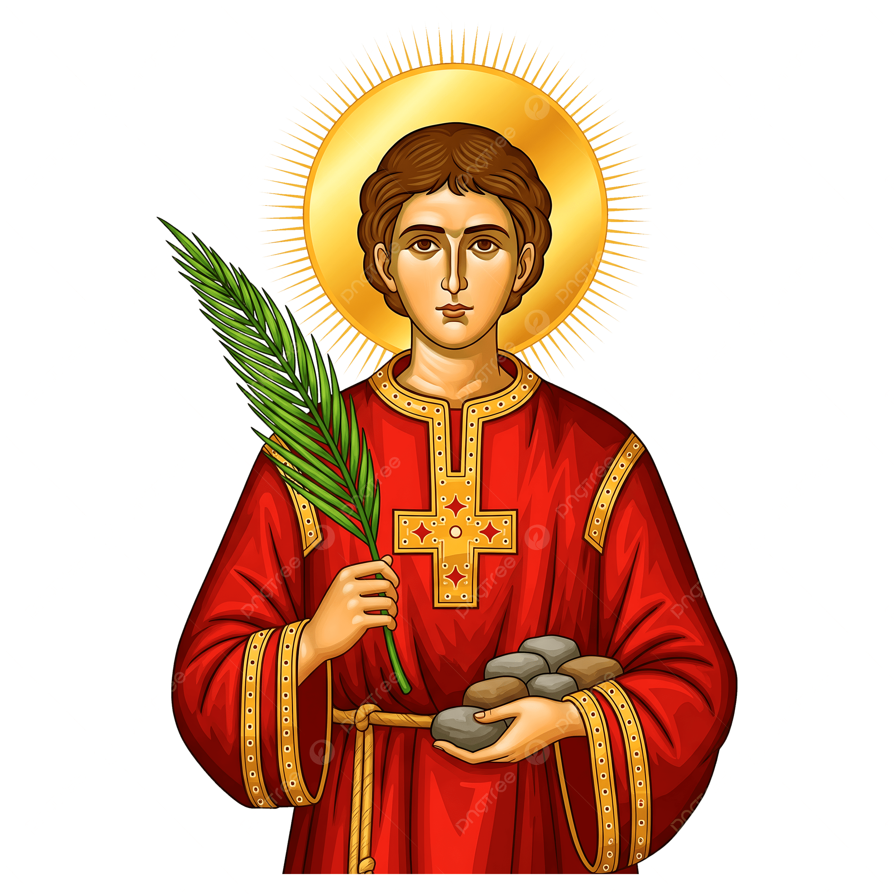
Who was St Stephen?
St Stephen lived around 2,000 years ago, not long after Jesus had returned to heaven.
The Apostles, like Peter and John, were very busy:
teaching people about Jesus
praying
helping the early Church grow
They chose seven good and wise men to help them look after the poor and those in need. Stephen was one of these men.
Stephen was known for being:
kind
honest
brave
full of faith
He helped people who were hungry or lonely and told others about Jesus’ love.

Slide 3
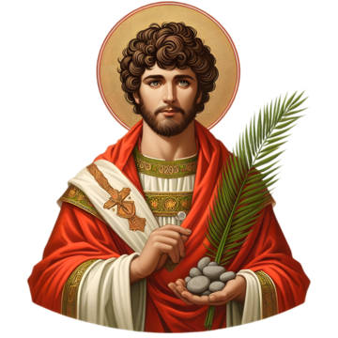
Why did Stephen get into trouble?
Stephen spoke bravely about Jesus.
He told people that:
Jesus is the Son of God
Jesus rose from the dead
Jesus came to save everyone
Some people did not like what Stephen was saying. They became angry because Stephen’s words made them question their own beliefs.
They told lies about Stephen and took him to court.

Slide 4

How did St Stephen become a martyr?
At the court, Stephen was not afraid.
He spoke clearly about God and Jesus, even though he knew he could be punished.
The people became very angry. They took Stephen outside the city and threw stones at him. This was how people were killed at that time.
While this was happening, Stephen prayed. He said:
“Lord Jesus, receive my spirit.”
“Lord, do not hold this sin against them.”
This sounds very much like Jesus on the cross, doesn’t it?
Stephen forgave the people who were hurting him.
That is why he is remembered as a true follower of Jesus because Stephen died for his faith, he is called a martyr.

Slide 5
Why is St Stephen a saint?
St Stephen is a saint because:
he lived a life of love and service
he trusted God completely
he was brave, even when he was afraid
he forgave others
Saints are people who help us learn how to follow Jesus in our own lives.
St Stephen reminds us to:
stand up for what is right
be kind, even when it is hard
forgive others

Slide 6
St Stephen’s feast day is on 26th December.
This is the day after Christmas Day.
The Church celebrates St Stephen so close to Christmas because:
Christmas reminds us that Jesus came to bring love and peace
St Stephen showed that love by giving his life
In some countries, people:
go to Mass
pray for courage and kindness
exchange gifts
help people who are poor or lonely
In the UK, St Stephen’s Day is also known as Boxing Day, which reminds us of sharing with others, just as Stephen did.

Slide 7
What can we learn from St Stephen?
We can learn to:
be brave when we stand up for what is right
help people who are in need
forgive others
trust God, even when things are difficult
We may not be asked to be martyrs like Stephen, but we can be witnesses to Jesus every day by how we act.

Slide 8
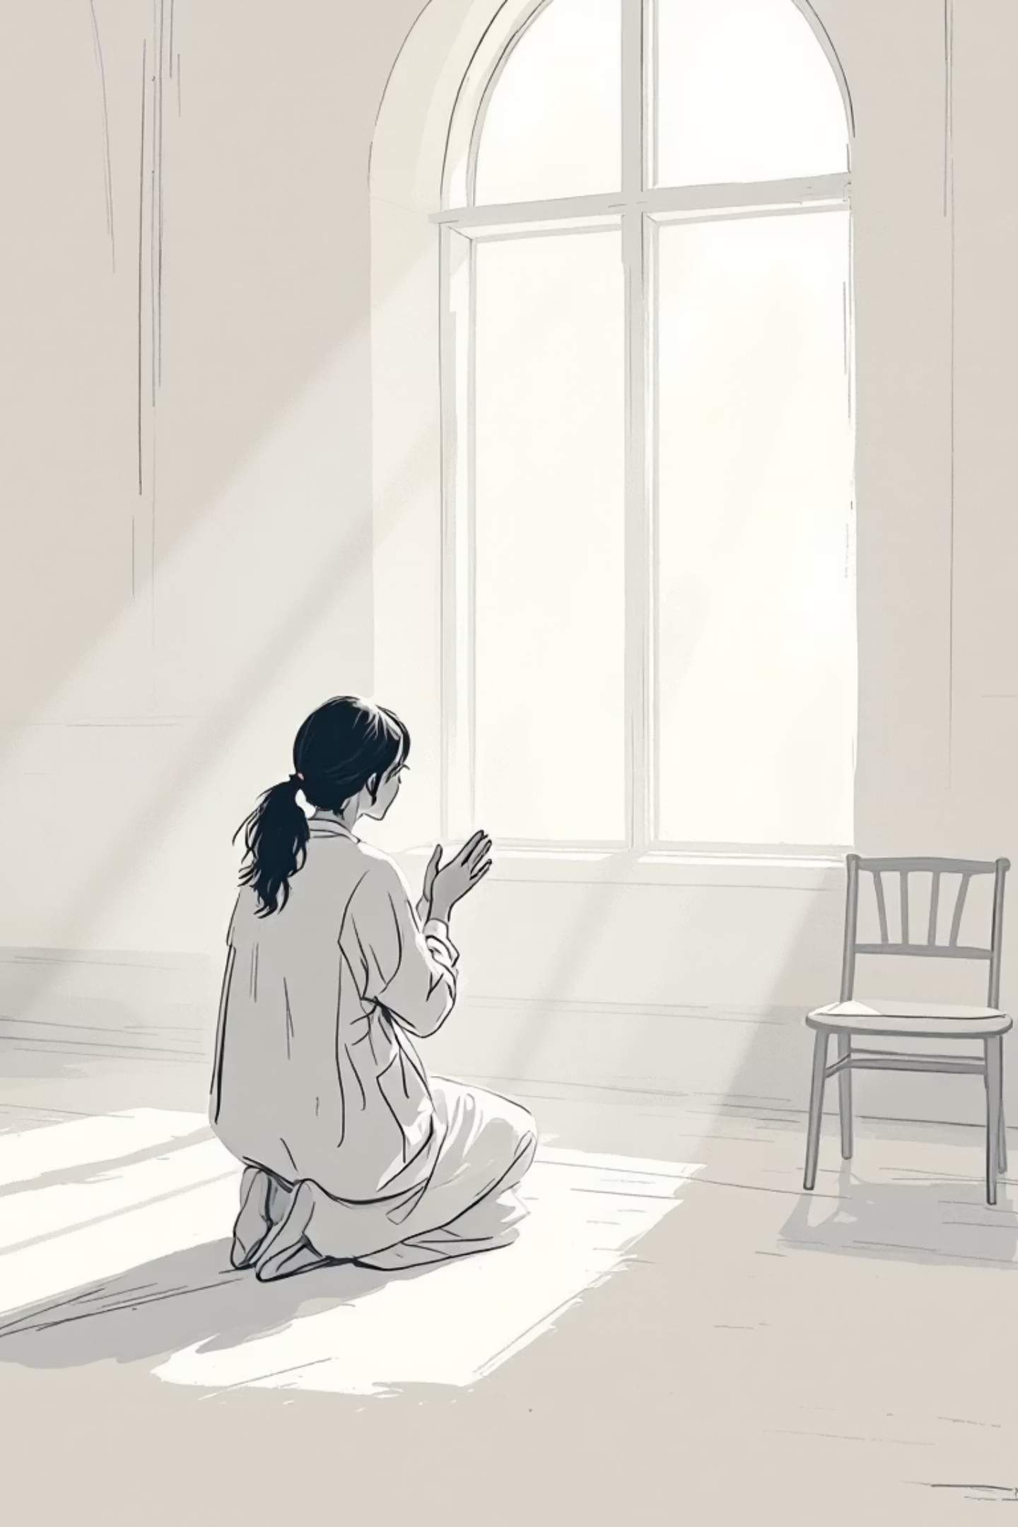




A Moment for Reflection
Let us pause and reflect quietly on these questions in our hearts
When is it hard to do the right thing?
Consider the times when standing up for truth
feels challenging or scary
How can I be brave for others?
Think about ways you can show courage in defending or helping someone today
Who do I need to forgive?
Bring to mind anyone who has hurt you and ask
God for a forgiving heart
Let us hold these thoughts quietly for a moment...

Slide 9
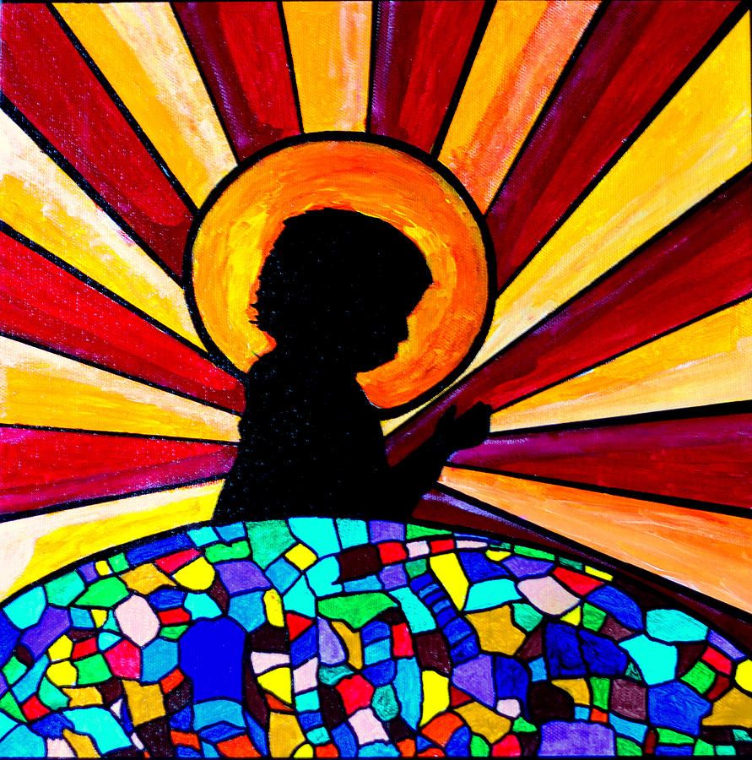
Let us pray…
Dear God,
Thank you for the example of St Stephen.
Help us to be brave, kind and forgiving.
Help us to follow Jesus in our words and actions.
Amen.

Slide 10
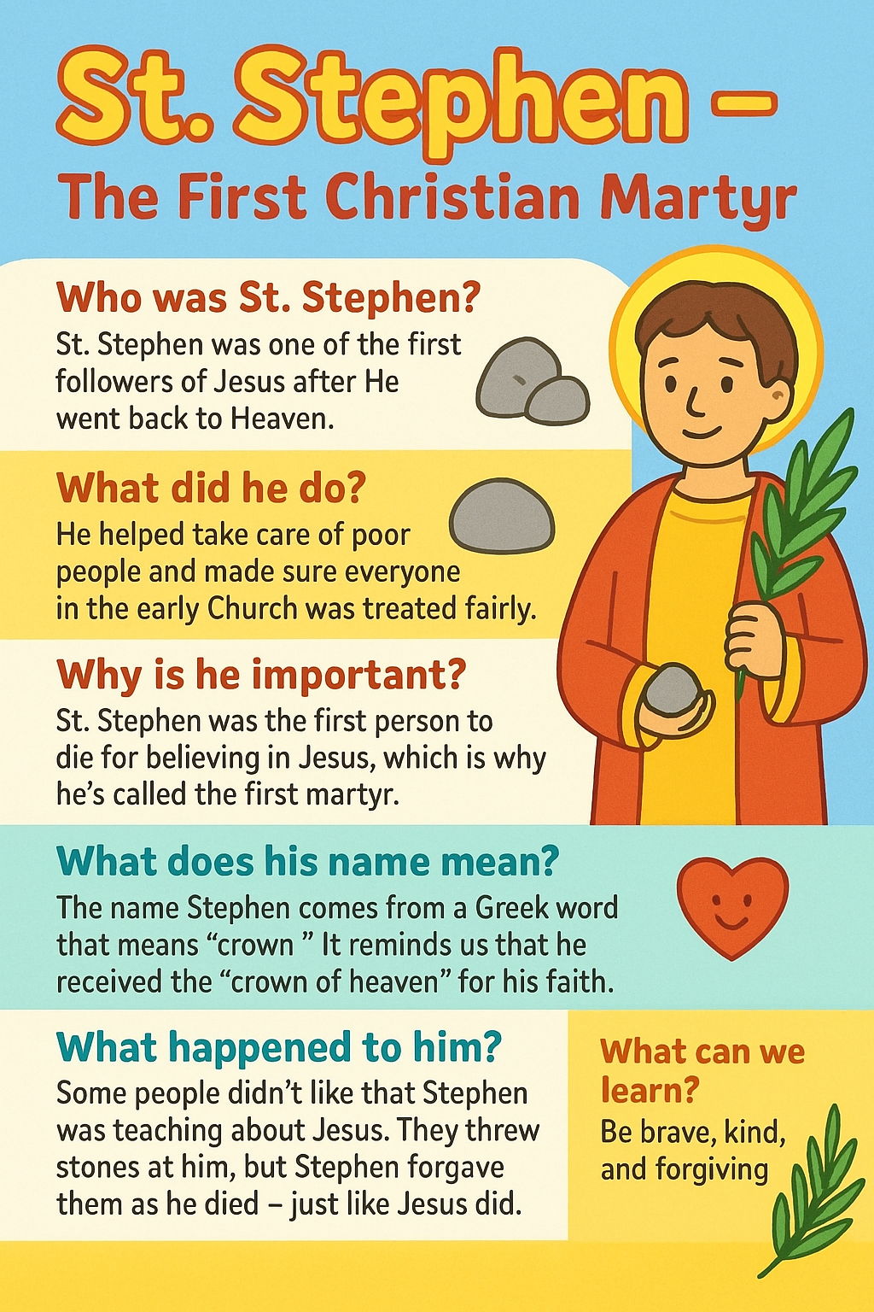
Key Facts

